Slide 1

Univertsity life.
Group four.

Slide 2
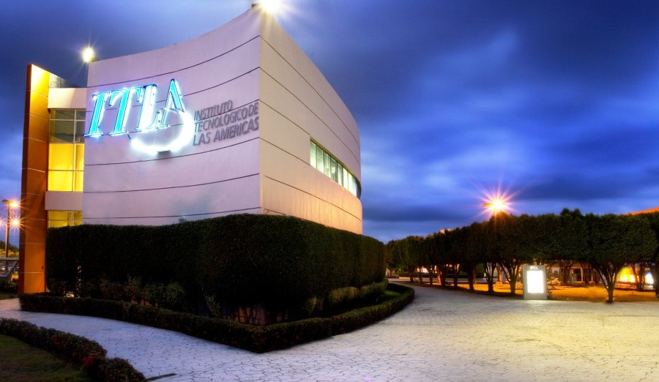
College studies.
ITLA students receive an academic degree in calculus, history, English, computer science, etc... students receive 4- or 5-hour classes per subject. They receive classes 6 days a week.
Life on Campus.
In ITLA, students can opt for a residence and can share rooms with other students, they do not have a meal plan and most of them eat lunch outside the university or cook in their rooms.
Clubs.
Many ITLA students join literature or math clubs. They also join sports groups such as baseball, basketball, swimming, chess, volleyball, dance, soccer, etc. For example, there is a cleaning group that does community work cleaning nearby beaches and parks.

Slide 3
Careers and subjects in the semester
My name is Andy Bautista, and I am studying Multimedia. My subjects this semester are: English Levels 1-3, Ethics 1, Computer Fundamentals, Institutional Orientation, illustration and Universal History.
My name is Jesus, my career is Renewable Energy, in this semester I have seven subjects that are: Computer foundation, introduction to renewable energy, precalculation, Ethics, institutional orientation, Spanish Writing and English.
My name is Miguel Lopez, and I am studying software development. The subjects I am studying this semester are Introduction to Algorithm Development, English Levels 1-3, Ethics 1, Computer Fundamentals, Institutional Orientation, Pre-Calculus, and Universal History.
My name is Samir Soto, I am studying renewable energy, the topics I am studying this semester are: English levels 1-3, ethics 1, computer fundamentals, introduction to renewable energy, institutional orientation and Spanish writing

Slide 4
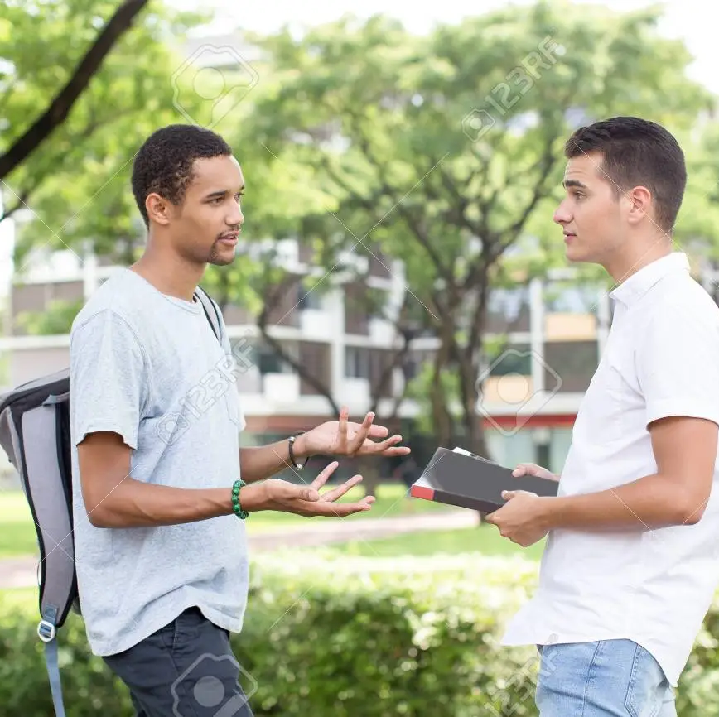
Conversation.
A: hello brother, how is everything?
B: all good, and you how are you?
A: I'm fine, thank you. How are you doing with your university?
B: I'm doing very well
.A: oh, fantastic, how many subjects do you have?
B: I have 6 Subjects
A: what are the subjects you have?
B: I have, history, IT, Mathematics, English, Spanish and Ethics.
A: ahh that's super good. Which is your favorite subject?
B: I prefer history.
.A: ok bro nice to see you, hope you do well.
B: Bye, see you later.

Slide 5
Thank you for your attention.

